Slide 1
Automation Testing using Selenium Tool
Girish kumar RAMACHANDRA
Surabhi khadke
Darshan shah

Slide 2
Contents
Testing Importance
Manual Testing
Automation Testing
Manual Testing and Automation Testing
Selenium Automation Tool
How it works
Exception Handling in Selenium
Components Tested
Demonstration Of The Project
Conclusion

Slide 3
Testing Importance
Software testing is really required to point out the defects and errors that were made during the development phases.
It is very important to ensure the Quality of the product. Quality product delivered to the customers helps in gaining their confidence.
Testing is required for an effective performance of software application or product.
The information from software testing helps with risk management.

Slide 4
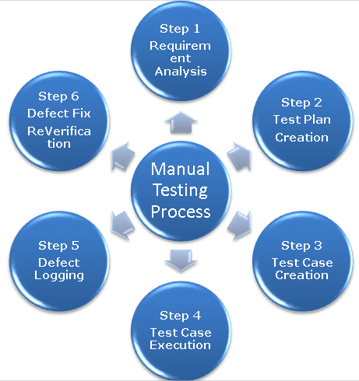
Manual Testing
Procedure of Manual Testing
The tester manually executes test cases without using any automation tools.
Test cases are planned to cover almost 100% of the software application
As manual testing involves complete test cases, it is a time consuming test.
Notes:
Ref:-http://toolsqa.com/software-testing/manual-testing/

Slide 5
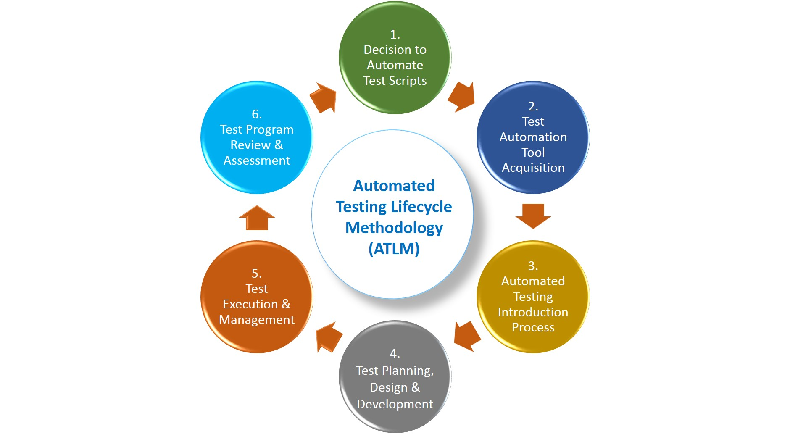
Automation Testing
Automation testing is an Automatic technique where the tester writes scripts by own and uses suitable software to test the software. It is basically an automation process of a manual process.
Automation testing is a technique which uses an application to implement entire life cycle of the software in less time and provides efficiency and effectiveness to the testing software.
Notes:
Ref:-https://dzone.com/articles/automated-testing-vs-manual-testing

Slide 6
Manual Testing and Automation Testing
Manual Testing | Automation Testing
Manual testing is not accurate at all times due to human error, hence it is less reliable. | Automated testing is more reliable, as it is performed by tools and/or scripts.
Manual testing is time-consuming, taking up human resources. | It is significantly faster than a manual approach.
Manual testing is only practical when the test cases are run once or twice, and frequent repetition is not required. | Automated testing is a practical option when the test cases are run repeatedly over a long time period.
Notes:
Ref:-https://dzone.com/articles/automated-testing-vs-manual-testing

Slide 7
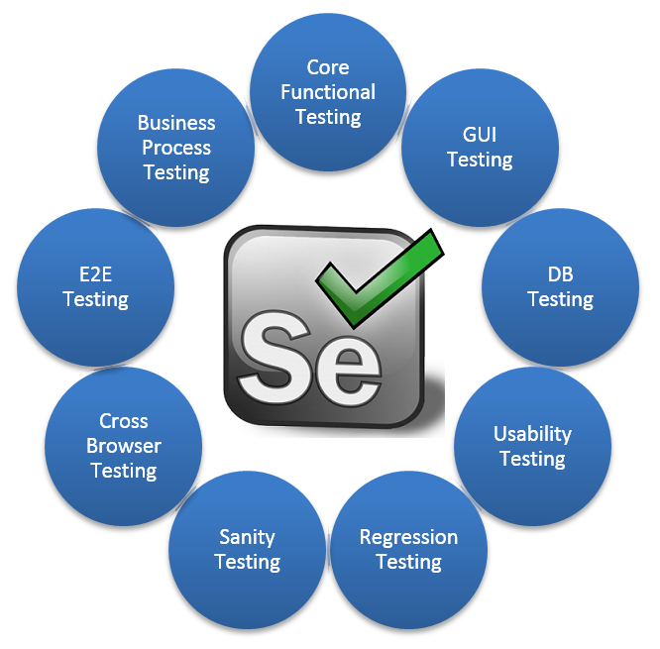
Selenium Automation Tool
Selenium is a portable software-testing framework for web applications. Selenium is a tool for authoring tests without the need to learn a test scripting language
The tests can then run against most modern web browsers

Slide 8
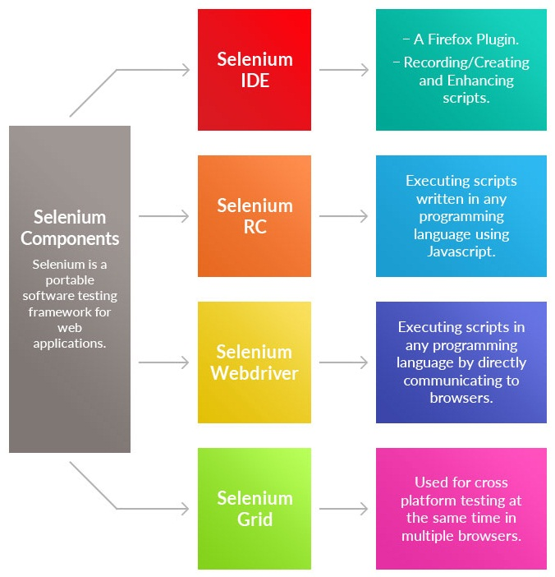
How it Works
IDE: a simple Graphical User Interface (GUI) for recording user actions.
Selenium RC: Selenium Remote Control (RC) is a software testing tool that allows writing automated web application UI tests
Selenium WebDriver: WebDriver extends its support to many latest browsers and platforms, unlike Selenium IDE
Selenium Grid: Selenium Grid is a tool used together with Selenium RC to run parallel tests across different machines and different browsers all at the same time.

Slide 9
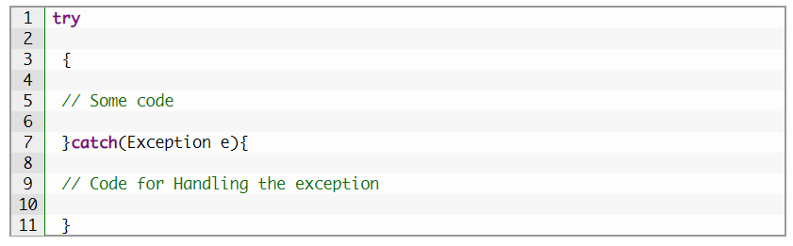
Exception Handling in Selenium
Try/Catch: A method catches an exception using a combination of the try and catch keywords. Try is the start of the block and Catch is at the end of try block to handle the exceptions.

Slide 10
Components Tested
We have used 4 websites for testing and following are the components tested for each website:-
www.ultimateQA.com
Button Click
Search Option
Toggling tabs
Email alert
2) www.the-internet.herokuapp.com
Checkbox
File download testing
Forgot password testing
Drop down testing
Menu form Authentication
Drag and drop, Hover over actions

Slide 11
Components Tested
3) www.demoQA.com
bookmark comment and leave a reply
E training review and FAQ review
4) www.compendiumdev.co.uk
Hire me review and enquiry
Contact us page
Books review
Downloading samples
Other components tested for each website:-
website loading issue
current webpage title retrieval
current webpage URL retrieval
current page source retrieval
clearing cookies

Slide 12
DEMONSTRATION OF THE PROJECT

Slide 13
Conclusion
Automation testing is a best way to fulfill most of the testing goals with effective resources and time.
But be careful before using the automation tool that fulfills the requirement of the application because no any tool can fulfill 100% requirement.
The right selection of automation tool, testing process, and team, is very important for automation to be successful.
Manual and automation methods go hand-in-hand for successful testing.

